Slide 1
DATA SCIENCE Project
Bigmart

Slide 2
TABLE OF CONTENTS
01
02
03
EVALUATION
PROBLEM DEFINITION
PROCESS

Slide 3
01
Problem Definition

Slide 4

Used-Cars’ price predition
The data scientists at BigMart have collected 2013 sales data for 1559 products across 10 stores in
different cities. Also, certain attributes of each product and store have been defined. The aim of
this data science project is to build a predictive model and find out the sales of each product at a particular store. Using this model, BigMart will try to understand the properties of products and stores which play a key role in increasing sales.

Slide 5
02
Process

Slide 6
OUR PROCESS PIPELINE
EDA
PREPROCESSING
MODELLING
Feature Engineering

Slide 7
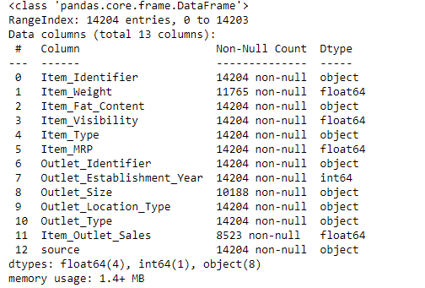
EDA
In this part we usually do initial investigations on data so as to discover patterns, to spot anomalies, to test hypothesis and to check assumptions with the help of summary statistics and graphical representations.

Slide 8
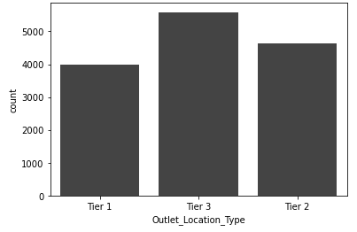
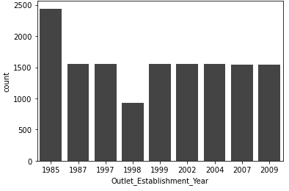
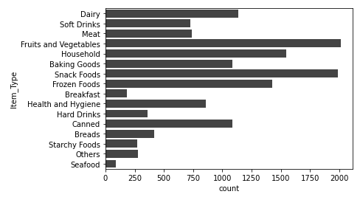
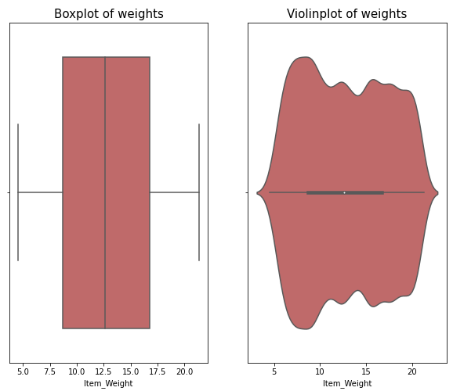
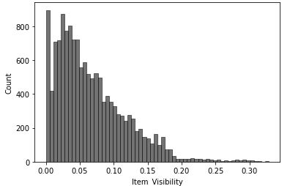
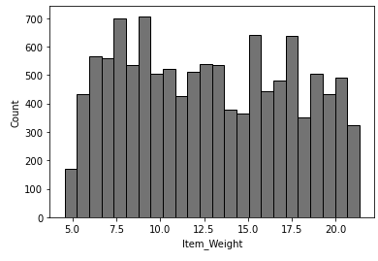
EDA: Univariate Exploration

Slide 9
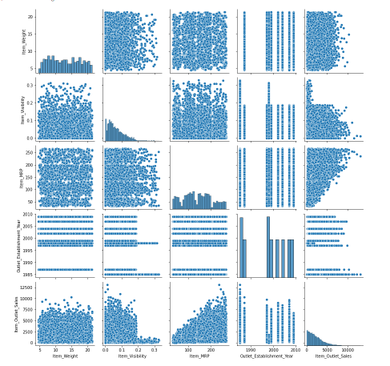
EDA: Bivariate Exploration
We could infer some points:
1. Item_Visibility is inversely proportional to the sales
2. Item_MRP is directly proportional to the sales

Slide 10

Feature Engineering
In this part, we try to manipulation — addition, deletion, combination, mutation — of the data set to improve machine learning model training.
I applied some ft techniques like:
Normalized features
Performed techniques to add features
Encoding
Scaling

Slide 11
PREPROCESSING
The goal here is to prepare the dataset to be modelled. The main aspects were:
Missing Values Treatment
Outliers' removal
Splitting
Feature selection

Slide 12

MODELLING
The goal of the final process is to create a model that can predict the target value with an acceptable error.
Main parts:
Linear Regression
Lasso Regression
XGB
Gradient boosting regressor

Slide 13
03
EVALUATION

Slide 14
Evaluation
The best model was the Lasso Regression which had a MAE score of 1272

Slide 15
THANK YOU

